Slide 1


Credit Card Fraud Detection
Using Machine Learning and Anomaly Detection
Presented by: Preksha Ruhela (202410116100148),
Nikhil (202410116100132),
Priyakant Tyagi (202410116100151)

Slide 2

Introduction to Credit Card Fraud
What is Credit Card Fraud?
Importance of Fraud Detection
Unauthorized use of credit card info for financial gain.
Protects users and financial institutions from losses.

Slide 3

Problem Statement
Rising Online Fraud
Detection Goal
Increased digital transactions lead to higher fraud rates.
Accurately identify fraudulent transactions in real time.

Slide 4

Dataset Description
Source
Kaggle Dataset
Total Records
284,807
Fraud Cases
492 (Highly imbalanced)
Features
Time, Amount, V1-V28, Class Label

Slide 5

Data Preprocessing Steps
Missing Values
Checked dataset; none found.
Normalization
Normalized 'Amount' to improve model performance.
Data Split
Divided data into 80% training and 20% testing sets.

Slide 6
Exploratory Data Analysis
Transaction Distribution
Time vs Amount Scatter Plot
Observations
Majority are non-fraudulent; fraud cases are rare.
Anomalies detected in timing and transaction amounts.
Patterns show unusual transaction amounts at odd times.

Slide 7




Model Building Techniques
Logistic Regression
Random Forest
Isolation Forest
Ensemble method improving prediction accuracy.
Anomaly detection to isolate fraud patterns.
Baseline classifier with probabilistic outputs.

Slide 8
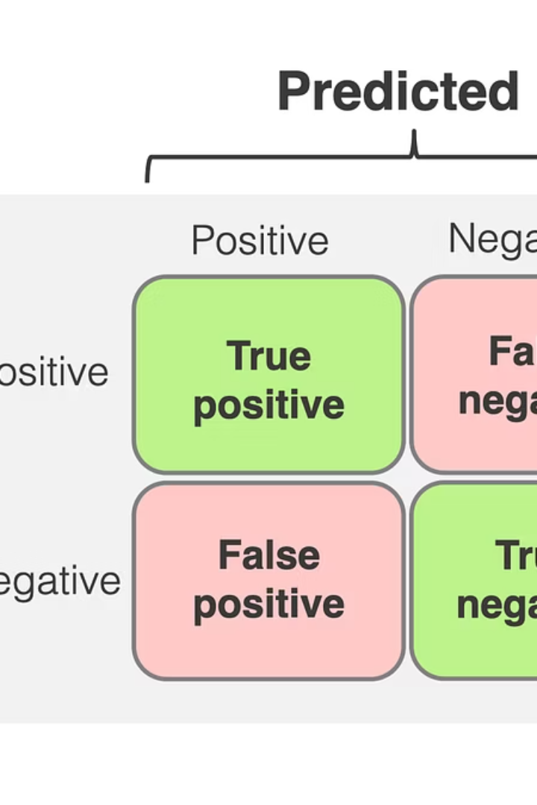
Confusion Matrix & Performance Metrics
True Positives (TP)
False Positives (FP)
Fraud detected correctly.
Normal transactions flagged as fraud.
Precision & Recall
Measures accuracy and completeness of detection.

Slide 9
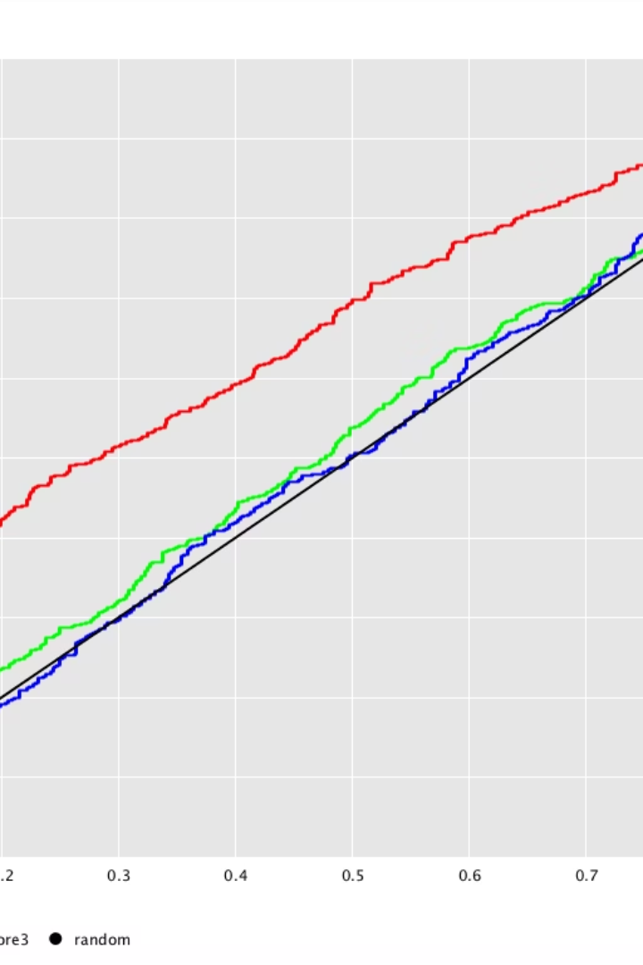
ROC Curve & Model Comparison
The ROC curve evaluates true positive rate vs. false positive rate.
AUC scores help compare model effectiveness in distinguishing fraud.

Slide 10
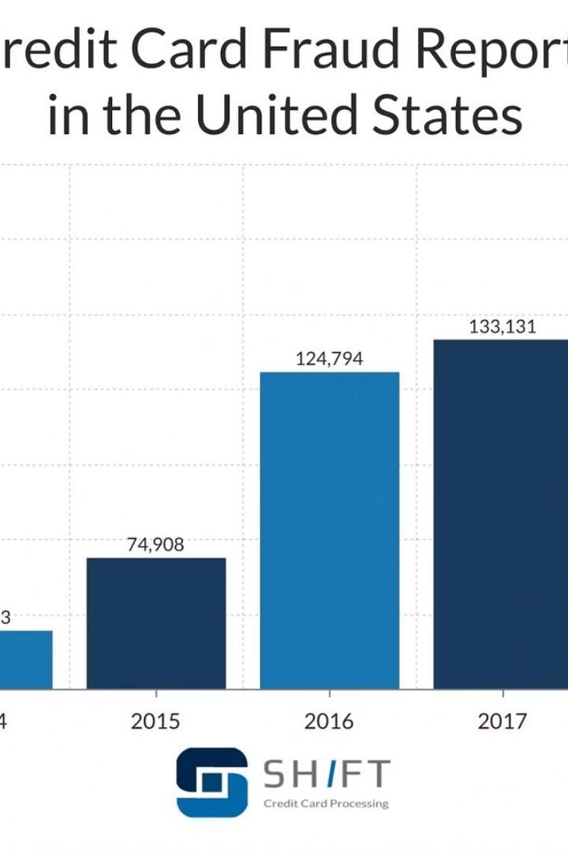
Credit Card Fraud Detection: Anomaly Visualization
The plot shows transaction amount over time. Normal transactions are in blue, frauds in red.
Isolation Forest helped us detect outliers effectively. Fraud transactions tend to have higher amounts and appear sparsely.

Slide 11
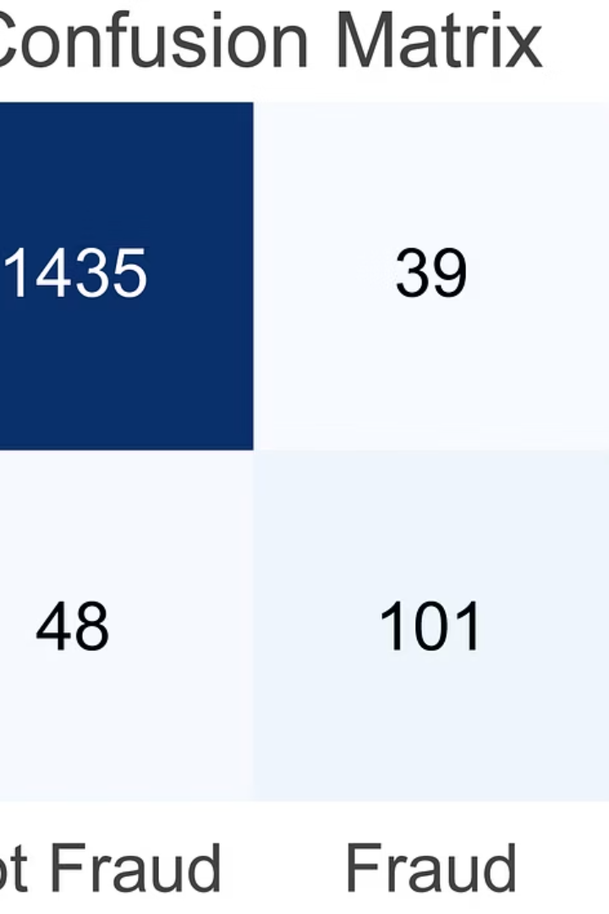
Model Results and Evaluation
Logistic Regression
Random Forest
Good accuracy, but lower recall on fraud cases.
Balanced performance with better precision and recall.
Isolation Forest
Best at detecting fraud with highest recall and F1-score.
Random Forest and Isolation Forest outperformed Logistic Regression due to handling class imbalance well.

Slide 12

Conclusion
Data Preprocessing
Model Building
Handled missing values, normalized features, and addressed imbalance.
Trained Logistic Regression, Random Forest, and Isolation Forest models.
Fraud Detection Success
Isolation Forest identified fraud with strong accuracy.
Future work: Real-time detection and deep learning to improve accuracy further.

Slide 13

Thank You !!

